Slide 1
Financial Aid 101
Mariah Schilt, Systems Analyst
Alora Blue, Financial Aid Loan Specialist
Office of Financial Aid & Scholarships at MSUB

Slide 2
Topics
HOW much does college cost?
WHAT is financial aid?
HOW do I apply for financial aid?
College is Possible!

Slide 3
How much does college cost?
2 or 4 year?
You want to find a college that fits your budget, so you browse some websites…
Public or private?
In-state or out-of-state? (WUE?)
Full-time or part-time?

Slide 4
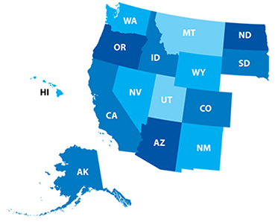
WUE/WICHE Information
Western Undergraduate Exchange Program – WUE
Western Interstate Commission for Higher Education - WICHE
Eligible students get reduced out-of-state tuition rate of 150% of resident tuition at participating two- and four-year college programs outside of their home state.
Reduced tuition rate is not automatically awarded.
Many institutions limit the number of new WUE/WICHE awards each academic year, so apply early!
http://wue.wiche.edu

Slide 5
Sticker Price vs. Net Price

Slide 6
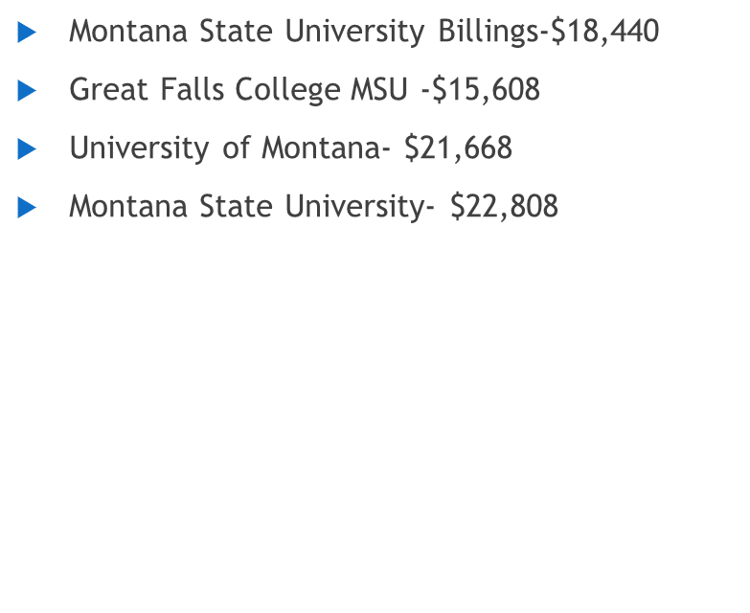
Cost of Attendance
University of Montana Western-$20,722
Montana State University-Northern –$17,720
Flathead Valley Community College- $16,124
Fort Peck Community College- $15,100

Slide 7
What is Expected Family Contribution (EFC)?
Calculated using info from FAFSA
Stays the same regardless of college
Cost of Attendance
-Expected Family Contribution (parent & student)
= Financial Need → types of aid you may receive

Slide 8
What is the FAFSA form used for?
FAFSA= Free Application for Federal Student Aid
Use FAFSA to determine eligibility and apply for:
Grants
Work Study
Loans
Some State aid
Will we qualify?
Every family who applies can receive some type of aid
Non-need based student loans are available to any student
Student must have HS Diploma, GED, HiSet, or homeschool completion certificate

Slide 9
How do you get financial aid for college?
1
Free Application for Federal Student Aid
2
Scholarship Applications
Institution (School)
State
Outside Scholarships
Every year, submit applications in the fall for the following year. Deadlines vary.

Slide 10
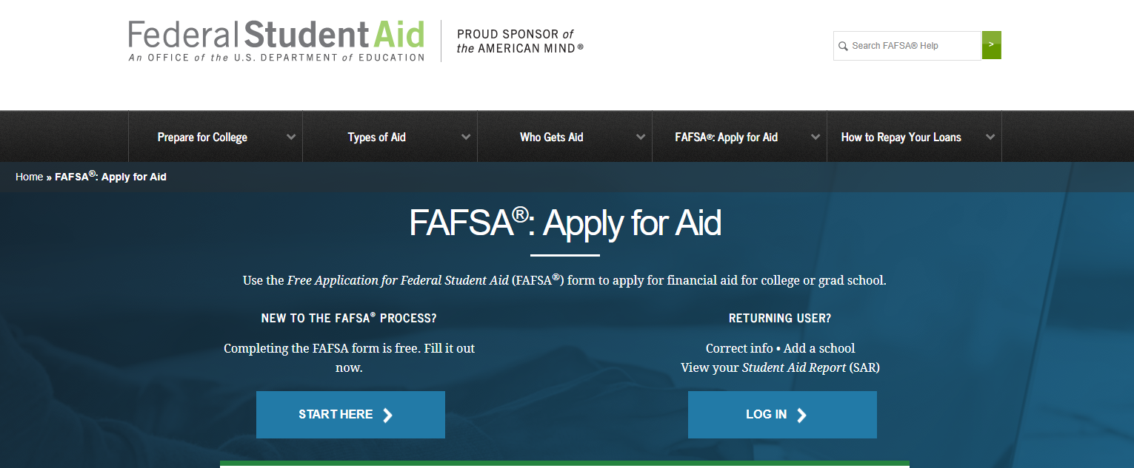
Free Application For Federal Student Aid (FAFSA)
Montana’s FAFSA Priority Filing Date is December 1st for the upcoming Fall semester.

Slide 11
Things you need for FAFSA
FSA ID-Username and Password
Both the Student & at least 1 Parent will need to create one
FAFSA.ed.gov (Make sure you are on the correct government site)
Social Security Numbers & Birthdates
Student’s and Parents’
Income Tax Record & W2s
2020-2021 aid year will use 2018 Income*
Records of Untaxed Income
Record of Assets
Does not include the home or family farm where you live, retirement savings or personal possessions
The value of your small business – if you own more than 50% of the business and employ 100 or fewer employees

Slide 12
Federal Student Aid (FSA) ID
Website: https://fsaid.ed.gov
Student & one parent must apply for FSA ID
Requires separate emails for each
Legal electronic signature on FAFSA & loan MPN
Links to IRS to transfer federal tax date into FAFSA
Matches to social security administration, so verify info is correct
Should not be shared with anyone

Slide 13
Completing the FAFSA
Eligibility:
Degree seeking
Citizenship status
Selective Service registration
Maintain Satisfactory Academic Progress (SAP)
Pell Eligibility – 12 semesters max (F/T)

Slide 14
Dependent vs. Independent
Independent
Legally married as of the date FAFSA application is submitted
Provide over 50% of the living support for a child or legal dependent
Veteran or Active member of U.S. Armed Services
Orphan or Ward of the Court or Foster Care as of age 13
Court ordered emancipated minor
Court ordered legal guardianship
Homeless or unaccompanied youth
If none of these apply and you feel you have an extenuating circumstance which prevents you from entering Parent information, contact your school’s Financial Aid Office for more information.
Otherwise, you will be considered a dependent student for financial aid purposes.

Slide 15
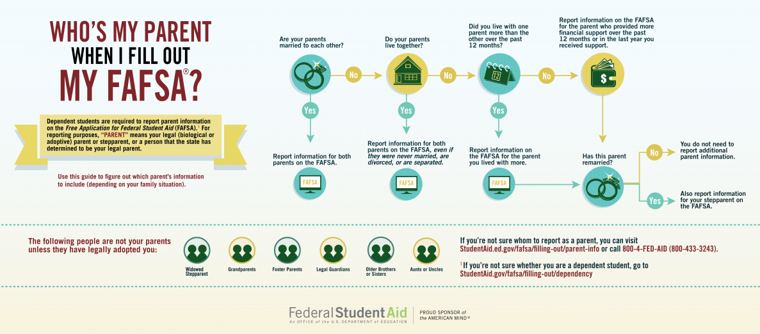

Slide 16
The IRS Data Retrieval Tool
Transfers Federal tax data from IRS to FAFSA
FAFSA indicates tax data has been verified by IRS
Participation voluntary
Reduces documents needed by financial aid office
2020-2021 – Use 2018 Federal tax data (PPY)
Some unable to use IRS DRT. Examples include:
Filed an amended (corrected) tax return
Student or parent married but filed separately or head of household

Slide 17
I filed the FAFSA- now what?
Each school will tell you how much aid you can get at that school.
Once you decide which school to attend, keep in touch with the financial aid office to find out when and how you will get your aid.
NOTE: If your family has experienced a significant change in income, the financial aid office can re-evaluate your situation.

Slide 18
Federal Student Aid/FAFSA
Grants
Pell grant
Federal SEOG= Federal Supplemental Educational Opportunity Grant
FREE money
Need-based
Work-study
Need-based
Earn as you go → student earns a paycheck
Requires you to find a work study job
Some schools will assign a job to you, but others will require you to find a job
Most schools will have both on campus employers and off campus employers
Off campus employers are usually non-profit

Slide 19
Federal Student Aid/FAFSA
Loans
May be an option, but be responsible about borrowing
Subsidized vs. Unsubsidized
Unsubsidized loan accrues interest while student is in school
Repayment does not begin until 6 months after graduation or after student drops below 6 credits
Parent PLUS loan are a loan in the Parent’s name
Loan is based on credit, so it requires the Parent to complete a loan application
If Parent is denied based on credit, student becomes eligible for additional Unsubsidized loans
Repayment begins 60 days after fully disbursed
Parent has the option to request a deferment until student has graduated
Interest accrues immediately
Private Education Loan are credit based and require the student to complete an application with the lender.
Often have higher interest rates and less repayment options → Use a last resort

Slide 20
Institution Type | School A Four-year Private | School B Four-year Public | School C 2-Year CC/Tech
Cost (COA) estimate | $ 40,000 | $ 20,000 | $ 15,000
EFC | 0 | 0 | 0
Need | 40,000 | 20,000 | 15,000
Pell (full-time) | 6095 | 6095 | 6095
Scholarships | 11,000 | 2,000 | 2,000
Work Study | 2,500 | 2,500 | 2,500
Subsidized Loan | 3,500 | 3,500 | 3,500
Unmet Need | 16,905 | 5,905 | 905
Unsubsidized Loan | 2,000 | 2,000 | 905
PLUS Parent Loan | $14,905 | $3,905 | $0

Slide 21
Scholarships
Types of scholarships
Need-based
Family Income
Financial aid eligibility
Parent’s Education
Academics
Field of Study
High School grades
Test Scores
Skills
Athletic
Art
Dance
Writing
Music
Activities
Leadership
Military Service (Family or Student)
Volunteer Work
Background
Culture
Ethnicity
First generation
Religion
Other
Company sponsored
Government Sponsored
Graduate School

Slide 22
Scholarships: Where are they?
Start with your local area
High School/School District
City/County
State/Residency
College/University
Institutional
Outside Organization scholarships
Search Tools
Be cautious of scams
Do not google search for scholarships
Instead use a reliable scholarship search, such as FastWeb
Do not pay to apply for a scholarship
Some companies will use scholarship submissions for “free” advertising
Some may ask you to create a commercial, an article or an advertisement about their company

Slide 23
Scholarship Deadlines
Depends on the donor/provider
Fall Timeline
Open: August/September
Close: November/December
Winter Timeline
Open: December/January
Close: February/March
Some colleges & universities will have freshman specific priority deadlines for scholarships
Spring Timeline
Open: January
Close: March/April
Summer Timeline
Open: June/July
Close: August/September

Slide 24
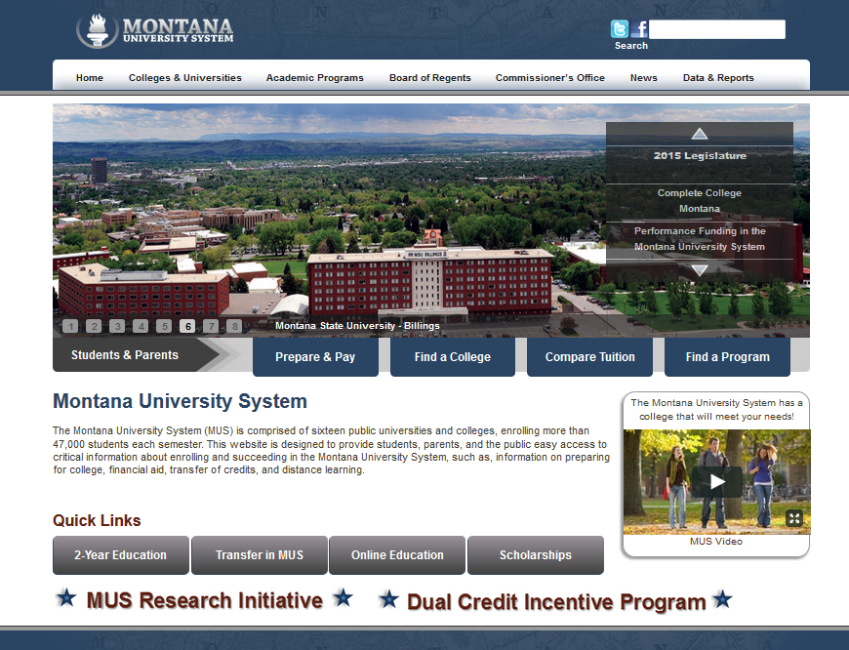
Montana University System scholarships
www.mus.edu

Slide 25
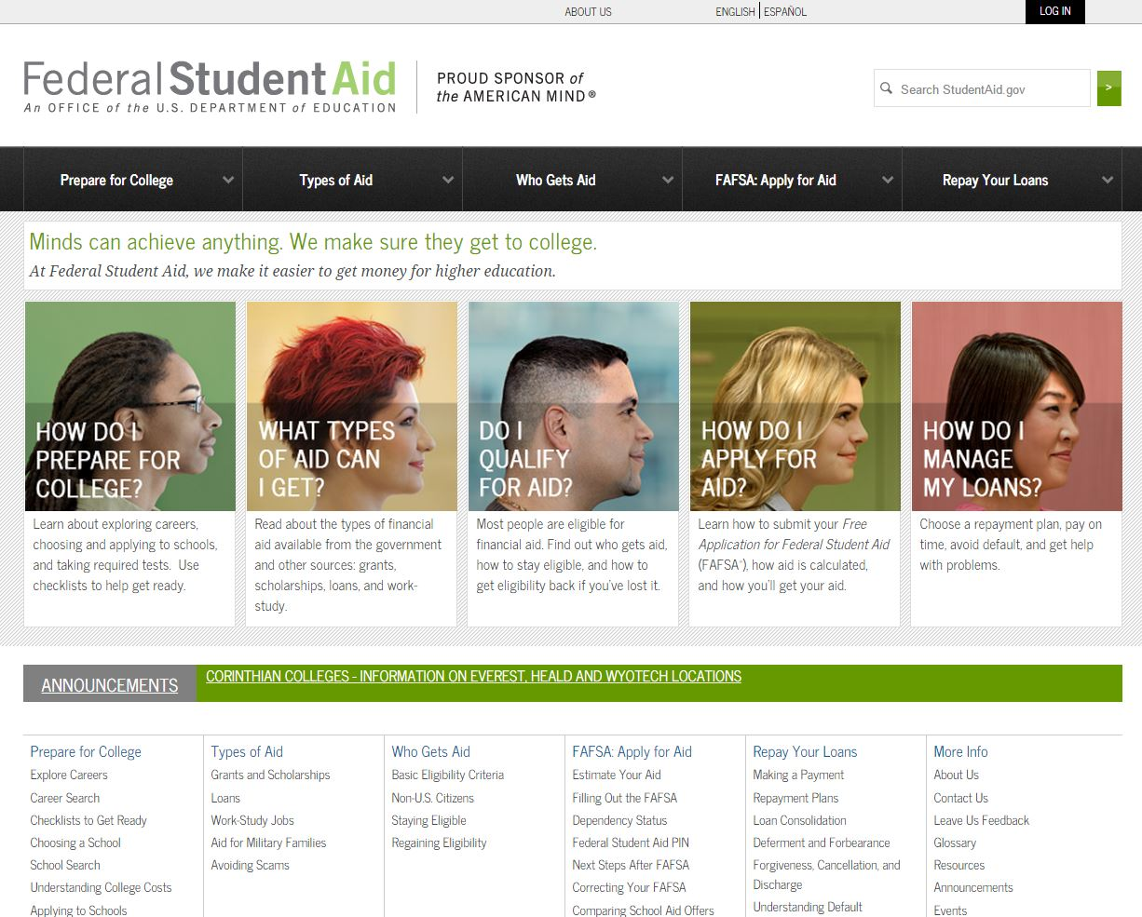
Outside (other) scholarships
Use FREE scholarship search tools
StudentAid.gov/scholarships

Slide 26
Additional Resources
Health & Human Services
Veteran’s benefits
Military Service Scholarship (ROTC)
Bureau of Indian Affairs (BIA) Grants
Tribal assistance
American Indian Tuition Waiver
Vocational rehabilitation
Notes:
Limited Funds, priority deadlines – check with agencies!
HHS – Nursing Scholarships, Housing
VA – Dependent benefits – check with VA rep – or student’s own VA benefits if a Veteran
BIA Grants – For undergrad students who are members of a tribe which is eligible for BIA funding – must demonstrate financial need, complete FAFSA, and complete separate grant app. Check with the individual agencies eligible: Blackfeet, Crow, Fort Belknap (Fort Belknap College now called “Aaniiih Nakoda” tribal agency name may also have changed), Fort Peck, Northern Cheyenne, and Wind River (Arapaho and Shoshone)
BIE – Bureau of Indian Education – check for Scholarships and grants for Native Americans at http://www.bie.edu/ParentsStudents/Grants/index.htm
Tribal assistance – check with Tribe – must be enrolled member, funding is limited, have to apply early to be considered – must have completed FAFSA and provide a needs analysis to be considered.
Tuition waiver – for Montana resident, at least ¼ quantum blood, need-based, some schools have limited amounts or requirements
Voc-Rehab – may provide tuition, book, transportation help for students with documented disabilities

Slide 27
Financial Aid Mistakes to Avoid
Most Common Mistakes:
Wrong Social Security numbers
Divorced/remarried parental information
Reporting assets and income incorrectly
Household size/# in college
Not filing early/missing out on additional funds
Procrastination/Not submitting the FAFSA
Paying for scholarship searches, FAFSA filing
Assuming that financial aid is for someone else

Slide 28
FAFSA Assistance Workshop
Who:
Hosted by TRIO Upward Bound
When:
Saturday, October 19th from 9am-12pm
Where:
Montana State University of Billings
Room: TBD
Why:
To help students and families of high school & college students submit their FAFSA applications

Slide 29
Questions?

